Slide 1
ICT 2103 Digital Logic Design
Prof. Dr. Muhammad Shahin Uddin
Email: shahin.uddin@mbstu.ac.bd

Slide 2
Combinational Circuits
Output is function of input only
i.e. no feedback
When input changes, output may change (after a delay)
Combinational
Circuits
n inputs
m outputs
•
•
•
•
•
•
✗

Slide 3
Combinational Circuit Vs. Sequential Circuit
Combinational Circuit | Sequential Circuit
Output depends only upon present input | Output depends upon present as well as past input
Speed is fast. | Speed is slow.
It is designed easy. | It is designed tough as compared to combinational circuits.
There is no feedback between input and output. | There exists a feedback path between input and output.
This is time independent. | This is time dependent.
Elementary building blocks: Logic gates | Elementary building blocks: Flip-flops
Used for arithmetic as well as Boolean operations. | Mainly used for storing data.
Combinational circuits don’t have capability to store any state. | Sequential circuits have capability to store any state or to retain earlier state.
As combinational circuits don’t have clock, they don’t require triggering. | As sequential circuits are clock dependent they need triggering.
These circuits do not have any memory element. | These circuits have memory element.
It is easy to use and handle. | It is not easy to use and handle.
Examples: Encoder, Decoder, and Multiplexer, Demultiplexer | Examples: Flip-flops, and Counters

Slide 4
Sequential Circuits
Asynchronous
Synchronous
Combinational
Circuit
Inputs
Outputs
Memory Elements
Combinational
Circuit
Inputs
Outputs
Flip-flops
Clock

Slide 5
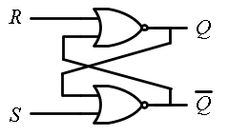
SR Latch :
NOR
NAND
Case 3:
S=1, R=1 Q=0 Q’=0
1 0 0 0
S=0, R=0 Q=0 Q’=0
Reset
Q=0
0 0 1 1
Reset
Q=0
0
Q’=1 0
1
0 0 1 0
Q=0
1 1 0 0
1
0
Set
=1
Set
=1
Case 1:
S=0, R=1
Q= 0
=1
No Change: (Memory )
A | B | Y
0 | 0 | 1
0 | 1 | 0
1 | 0 | 0
1 | 1 | 0
S=0, R=0
Q= 0
=1
S=1, R=0
Q= 1
=0
No Change: Memory
Case 2:
S=0, R=0
Q= 1
=0

Slide 6
Latches
SR Latch
S R Q₀ | Q | Q’
0 0 0 | 0 | 1
0 0 1 | 1 | 0
0 1 0 | 0 | 1
0 1 1 | 0 | 1
1 0 0 | 1 | 0
1 0 1 | 1 | 0
1 1 0 | 0 | 0
1 1 1
Q = Q₀
1
1
Q = 0
0
Q = 1
Q = Q’
0 | 0
Q = Q’
1
0

Slide 7
Latches
SR Latch
S R | Q
0 0 | Q₀
0 1 | 0
1 0 | 1
1 1 | Q=Q’=0
No change
Reset
Set
Invalid
S
Q
C S R | Q
0 x x | Q₀
1 0 0 | Q₀
1 0 1 | 0
1 1 0 | 1
1 1 1 | Q=Q’
SR Latch with Control Input
No change
No change
Reset
Set
Invalid
R
Q

Slide 8

Controlled Latches
D Latch (D = Data)
D
D
Q
C
Q
C D | Q
0 x | Q₀
1 0 | 0
1 1 | 1
No change
Reset
Set

Slide 9
Controlled Latches
D Latch (D = Data)
Timing Diagram
C
D
Q
D
C
Q
Q
t
Q (t+1) = D
When Clock is enabled
Q(t+1) = Q(t)
When Clock is disabled
C D | Q
0 x | Q₀
1 0 | 0
1 1 | 1
Output may change
No change
Reset
Set

Slide 10
Controlled Latches (Task 1)
D Latch (D = Data)
Timing Diagram
C
D
Q
D
Q
Q
Q (t+1) = D
When Clock is enabled
Q(t+1) = Q(t)
When Clock is disabled
t
C D | Q
0 x | Q₀
1 0 | 0
1 1 | 1
Output may change
No change
Reset
Set

Slide 11
Controlled Latches
D Latch (D = Data)
Timing Diagram
C
D
Q
D
Q
Q
C D | Q
0 x | Q₀
1 0 | 0
1 1 | 1
Output may change
No change
Reset
Set
Q (t+1) = D
When Clock is enabled
Q(t+1) = Q(t)
When Clock is disabled

Slide 12
Flip-Flops
Controlled latches are level-triggered
Flip-Flops are edge-triggered
Q (t+1) = D
When Clock is enabled
Q(t+1) = Q(t)
When Clock is disabled
C
CLK
Positive Edge
CLK
Negative Edge

Slide 13
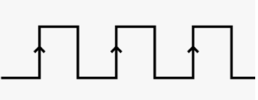
S | R | Q | Q’
0 | 0 | NO change
0 | 1 | 0
1 | 0 | 1
1 | 1 | Not Used
High Falling Edge
High
High Falling Edge

Slide 14
Flip-Flops
Master-Slave D Flip-Flop
D Latch
(Master)
D Latch
(Slave)
D
D
C
Q
D
C
Q
Q
Master
Slave
CLK
CLK
D
Looks like it is negative edge-triggered
Q_{Master}
Q_{Slave}

Slide 15
Flip-Flops
JK Flip-Flop
J | K | Q(t+1)
0 | 0 | Q(t)
0 | 1 | 0
1 | 0 | 1
1 | 1 | Q’(t)
D = JQ’ + K’Q
J
Q
Q (t+1) = D = JQ’ + K’Q
K
Q

Slide 16
Flip-Flops
T Flip-Flop
T
J
Q
T
D
Q
Q
K
Q
T
Q
D = JQ’ + K’Q
D = TQ’ + T’Q = T ⊕ Q
Q

Slide 17
Flip-Flop Characteristic Equations
Analysis / Derivation
J | K | Q(t) | Q(t+1)
0 | 0 | 0 | 0
0 | 0 | 1 | 1
0 | 1 | 0
0 | 1 | 1
1 | 0 | 0
1 | 0 | 1
1 | 1 | 0
1 | 1 | 1
No change
Reset
Set
Toggle
J
Q
K
Q

Slide 18
Flip-Flop Characteristic Equations
Analysis / Derivation
J | K | Q(t) | Q(t+1)
0 | 0 | 0 | 0
0 | 0 | 1 | 1
0 | 1 | 0 | 0
0 | 1 | 1 | 0
1 | 0 | 0
1 | 0 | 1
1 | 1 | 0
1 | 1 | 1
No change
Reset
Set
Toggle
J
Q
K
Q

Slide 19
Flip-Flop Characteristic Equations
Analysis / Derivation
J | K | Q(t) | Q(t+1)
0 | 0 | 0 | 0
0 | 0 | 1 | 1
0 | 1 | 0 | 0
0 | 1 | 1 | 0
1 | 0 | 0 | 1
1 | 0 | 1 | 1
1 | 1 | 0
1 | 1 | 1
No change
Reset
Set
Toggle
J
Q
K
Q

Slide 20
Flip-Flop Characteristic Equations
Analysis / Derivation
J | K | Q(t) | Q(t+1)
0 | 0 | 0 | 0
0 | 0 | 1 | 1
0 | 1 | 0 | 0
0 | 1 | 1 | 0
1 | 0 | 0 | 1
1 | 0 | 1 | 1
1 | 1 | 0 | 1
1 | 1 | 1 | 0
No change
Reset
Set
Toggle
J
Q
K
Q

Slide 21
Flip-Flop Characteristic Equations
Analysis / Derivation
J | K | Q(t) | Q(t+1)
0 | 0 | 0 | 0
0 | 0 | 1 | 1
0 | 1 | 0 | 0
0 | 1 | 1 | 0
1 | 0 | 0 | 1
1 | 0 | 1 | 1
1 | 1 | 0 | 1
1 | 1 | 1 | 0
J
Q
 |  |  |  | K
 |  | 0 | 1 | 0 | 0
J |  | 1 | 1 | 0 | 1
 |  |  | Q
K
Q
Q(t+1) = JQ’ + K’Q

Slide 22
Flip-Flop Characteristic Tables
D | Q(t+1)
0 | 0
1 | 1
D
Q
Reset
Set
Q
J | K | Q(t+1)
0 | 0 | Q(t)
0 | 1 | 0
1 | 0 | 1
1 | 1 | Q’(t)
J
Q
No change
Reset
Set
Toggle
K
Q
T
Q
T | Q(t+1)
0 | Q(t)
1 | Q’(t)
No change
Toggle
Q

Slide 23
Flip-Flop Characteristic Equations
D | Q(t+1)
0 | 0
1 | 1
D
Q
Q(t+1) = D
Q
J | K | Q(t+1)
0 | 0 | Q(t)
0 | 1 | 0
1 | 0 | 1
1 | 1 | Q’(t)
J
Q
Q(t+1) = JQ’ + K’Q
K
Q
T
Q
T | Q(t+1)
0 | Q(t)
1 | Q’(t)
Q(t+1) = T ⊕ Q
Q

Slide 24
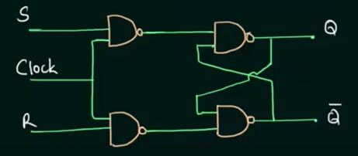
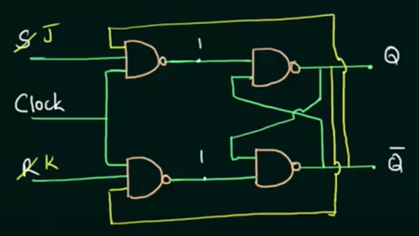
SR and JK flip flop

Slide 25
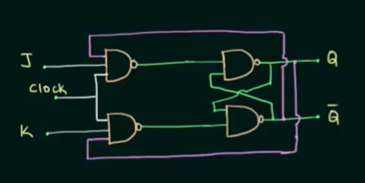
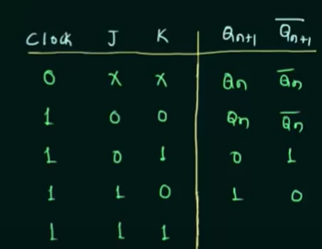
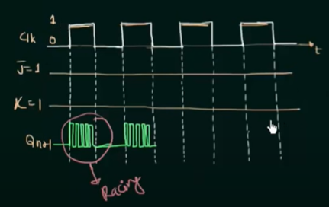
Race Around Condition of JK flip flop
1
0

Slide 26
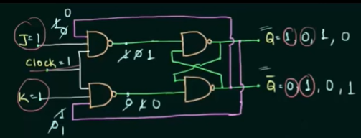
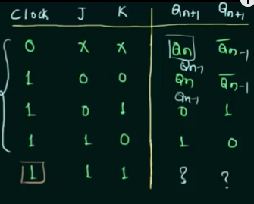
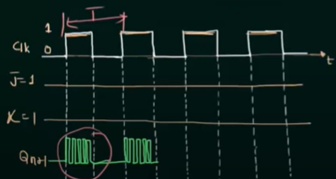
Race Around Condition of JK flip flop
1
0
Conditions to overcome Racing :
T/2<Propagation delay of FF x
Edge Triggering
Master-Slave

Slide 27
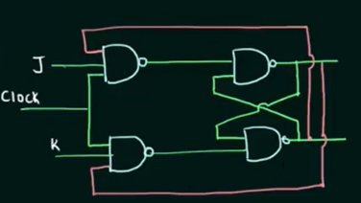
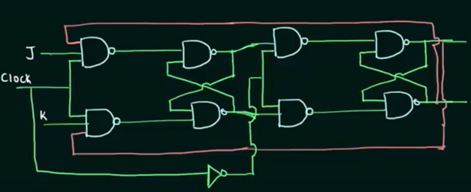
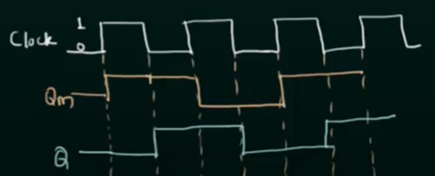
JK flip flop Master Slave Operation of JK flip flop
Qm
Slave
Master
T/2<Propagation Delay of FF
Edge Triggered
Master-Slave (M.S. operation is same as negative edge triggering])

Slide 28
Flip-Flop Characteristic Tables
D | Q(t+1)
0 | 0
1 | 1
D
Q
Reset
Set
Q
J | K | Q(t+1)
0 | 0 | Q(t)
0 | 1 | 0
1 | 0 | 1
1 | 1 | Q’(t)
J
Q
No change
Reset
Set
Toggle
K
Q
T
Q
T | Q(t+1)
0 | Q(t)
1 | Q’(t)
No change
Toggle
Q

Slide 29
Flip-Flop Characteristic Equations
D | Q | Q(t+1)
0 | 0 | 0
0 | 1 | 0
1 | 0 | 1
1 | 1 | 1
J | K | Q(t+1)
0 | 0 | Q(t)
0 | 1 | 0
1 | 0 | 1
1 | 1 | Q’(t)
Q(t+1) = D
D
Q
Q
D
0
1
0 1
0 | 0
1 | 1
Q
KQ
J
Q
J
0
1
00 01 11 10
0 | 1 | 0 | 0
1 | 1 | 0 | 1
K
Q
T | Q | Q(t+1)
0 | 0 | 0
0 | 1 | 1
1 | 0 | 1
1 | 1 | 0
Q(t+1) = JQ’ + K’Q
Q(t+1) = TQ’+T’Q =T ⊕ Q
Q
T
Q
T
0
1
0 1
0 | 1
1 | 0
Q

Slide 30
Clocked Sequential Circuits
Analyzing a clocked sequential circuit
Designing a sequential circuit to address a problem

Slide 31
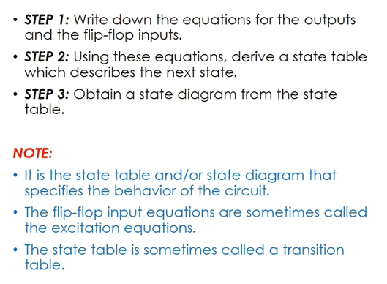
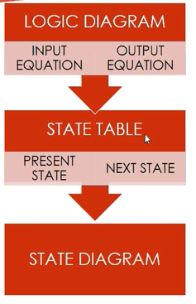
Analyzing a Clocked Sequential Circuit

Slide 32
State Table and State Diagram
State Diagram
The state diagram is the pictorial representation of the behavior of sequential circuits. It clearly shows the transition of states from the present state to the next state and output for a corresponding input.
State table
The information contained in the state diagram is transformed into a table called as state table or state synthesis table. Although the state diagram describes the behavior of the sequential circuit, in order to implement it in the circuit, it has to be transformed into the tabular form.

Slide 33
Analyzing a Clocked Sequential Circuit
A circuit will be given and we must understand the boundary between combinational stage and sequential stage
Then identify the following specifications
No. flip flops and what types
How many external input
How many external output
No. of state variable (n)
No of states, 2^{n}

Slide 34
Analyzing a Clocked Sequential Circuit
Write down the equation of Flip Flop Input, External Output [3]
Write down the equation for flip-flop output (known as state equation). This can be written by combining [3] with the flip flop’s driving equation.
Draw the state table
Draw the state diagram

Slide 35
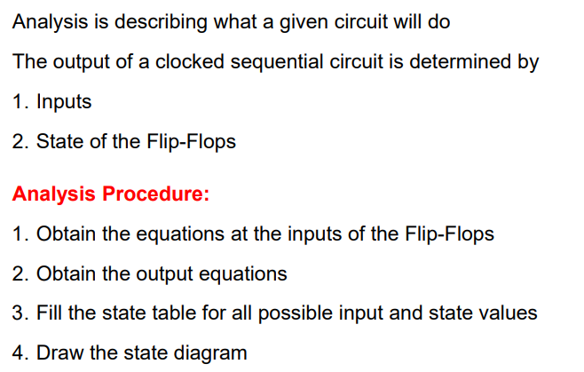
Analyzing a Clocked Sequential Circuit

Slide 36
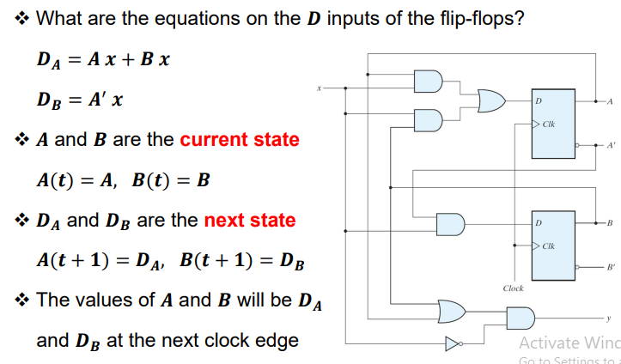
Analyzing a Clocked Sequential Circuit

Slide 37
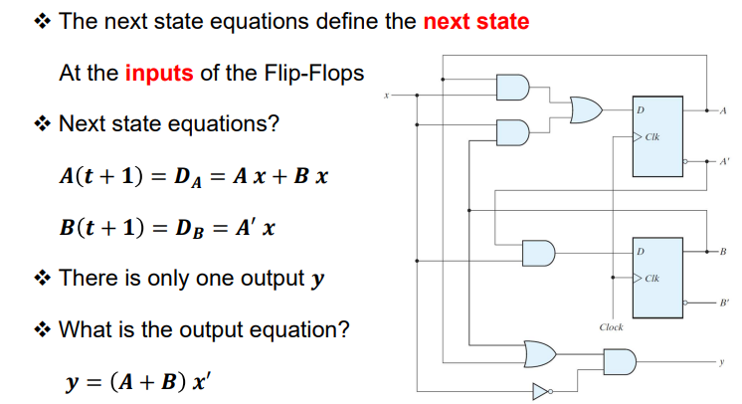
Analyzing a Clocked Sequential Circuit: Next state and output Equations

Slide 38
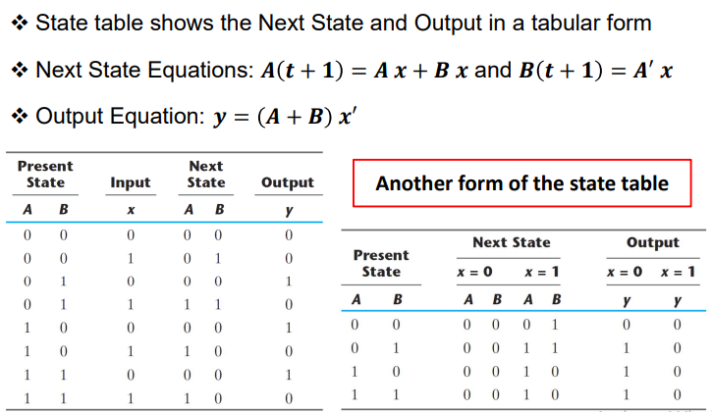
Analyzing a Clocked Sequential Circuit: State Table

Slide 39
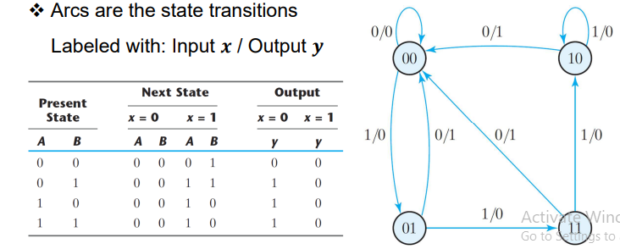
Analyzing a Clocked Sequential Circuit: State Diagram
v.v.i

Slide 40
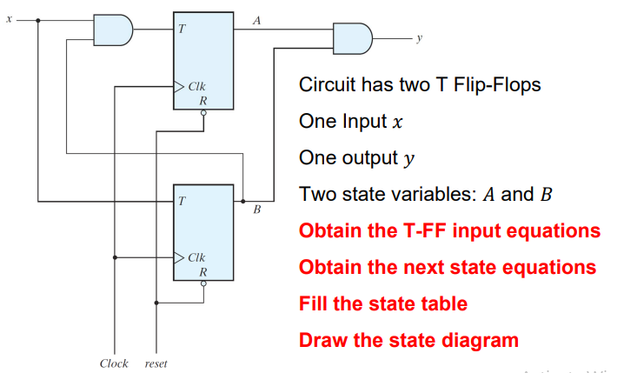
Analyzing a Clocked Sequential Circuit with T Flip-Flop

Slide 41
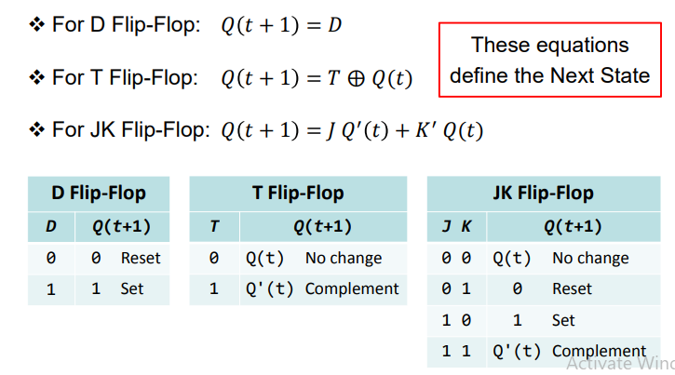
Recall: Flip-flop Characteristic Equation

Slide 42
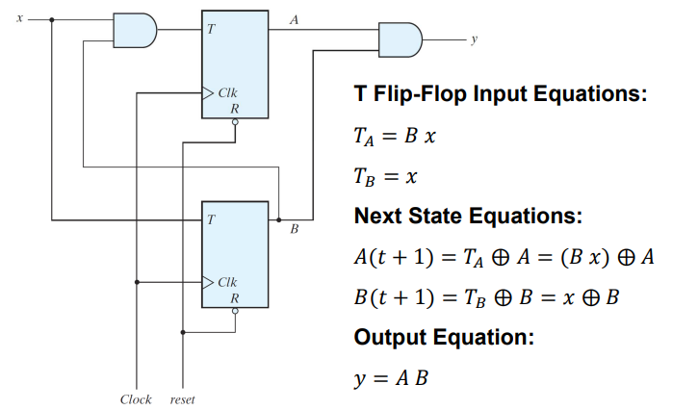
Sequential Circuit with T Flip-flops

Slide 43
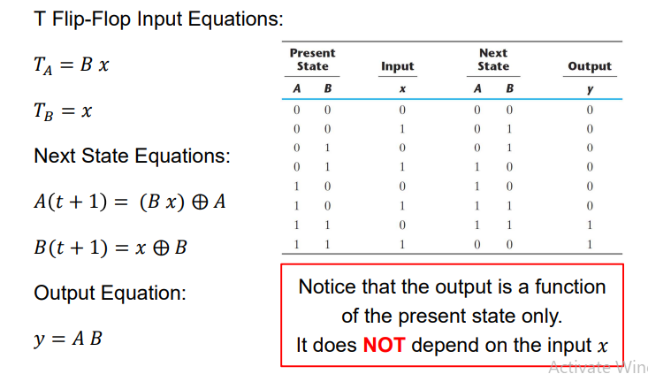
Analyzing a Clocked Sequential Circuit : From Next State Equations to state table

Slide 44
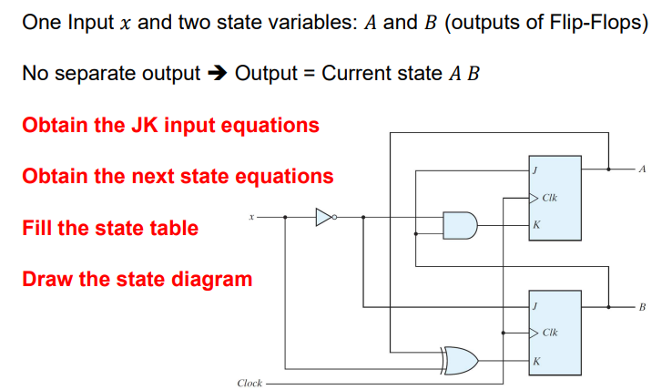
Sequential Circuit with JK FF
HW state diagram

Slide 45
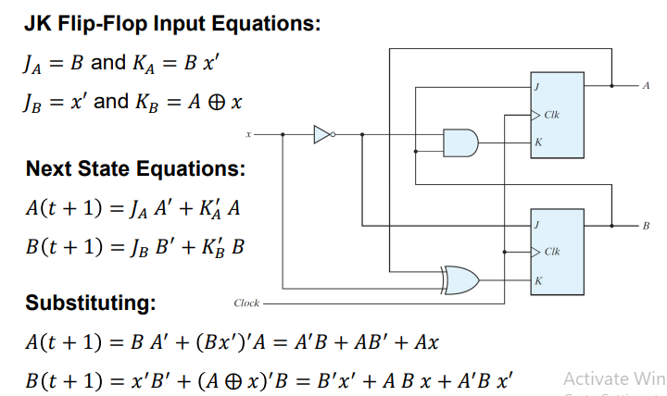
Analyzing a Clocked Sequential Circuit: JK Input and Next State Equations

Slide 46
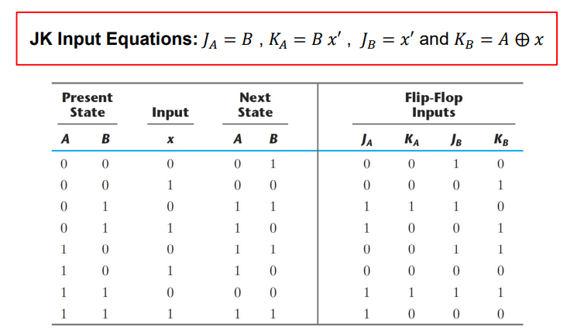
Analyzing a Clocked Sequential Circuit

Slide 47
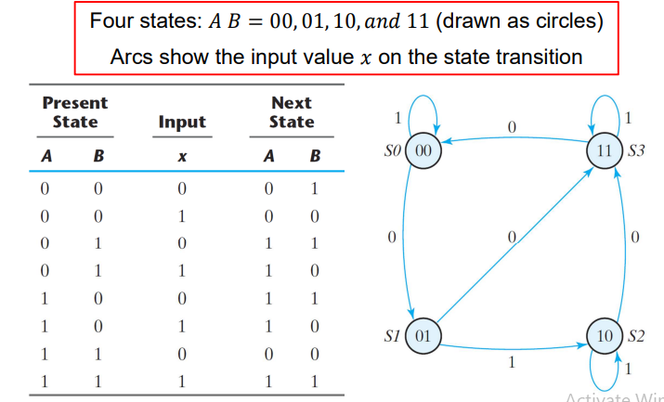
Analyzing a Clocked Sequential Circuit

Slide 48
Design a Sequential Circuit

Slide 49
Classifications of Counters
Asynchronous Counters
Only the first flip-flop is clocked by an external clock. All subsequent flip-flops are clocked by the output of the preceding flip-flop.
Asynchronous counters are slower than synchronous counters because of the delay in the transmission of the pulses from flip-flop to flip-flop.
Asynchronous counters are also called ripple-counters because of the way the clock pulse ripples it way through the flip-flops.
Synchronous Counters
All flip-flops are simultaneously clocked by an external clock.
Synchronous counters are faster than asynchronous counters because of the simultaneous clocking.
Synchronous counters are an example of a state machines design.

Slide 50
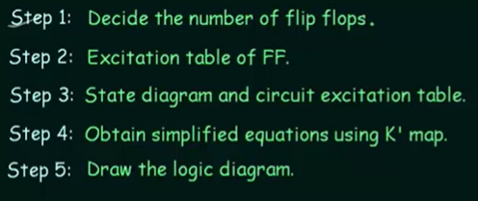
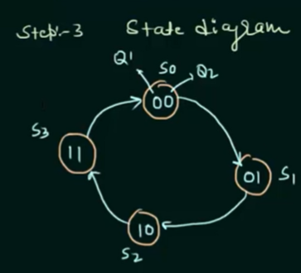

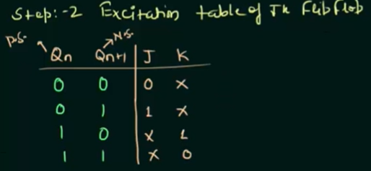
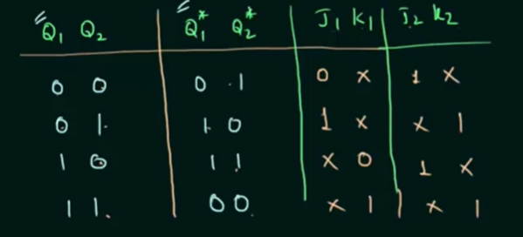
Design Synchronous Counter

Slide 51
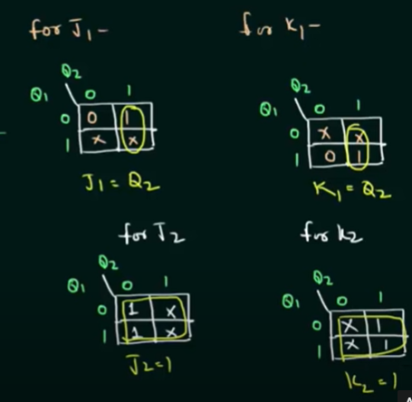
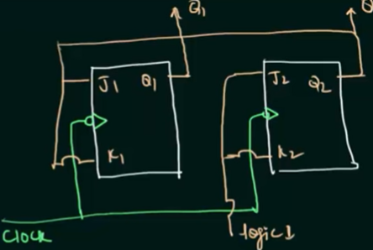
Design Synchronous Counter
0 0
0 1
0
1 1

Slide 52
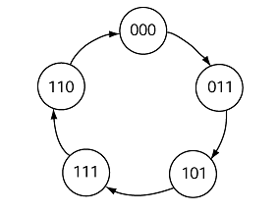
Binary Counter Example
How about a random number generator.
Check the following state diagram and try to identify what it is trying to do :

Slide 53

Binary Counter Example
How about a random number generator.
Check the following state diagram and try to identify what it is trying to do :

Slide 54
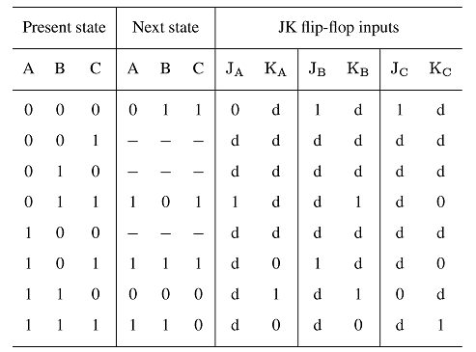
Binary Counter Example
How about a random number generator.

Slide 55
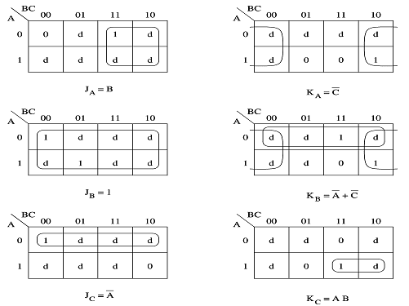
Binary Counter Example

Slide 56
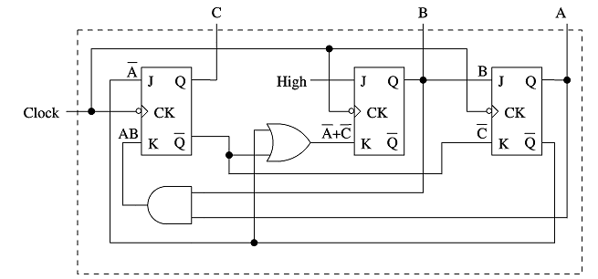
Binary Counter Example

Slide 57
Counters: Ring counter
Ring counter: Sequence is 1000, 0100, 0010, 0001
Assuming one of these patterns is the starting state
OUT1
OUT2
OUT3
OUT4
IN
D
Q
D
Q
D
Q
D
Q
CLK

Slide 58
Counters: Johnson counter
Johnson counter: Sequence is 1000, 1100, 1110, 1111, 0111, 0011, 0001, 0000
OUT1
OUT2
OUT3
OUT4
IN
D
Q
D
Q
D
Q
D
Q
CLK

Slide 59
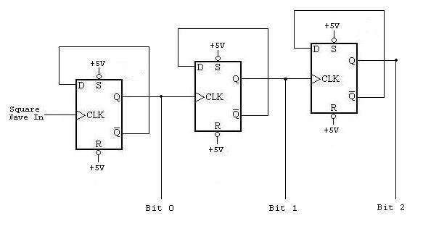
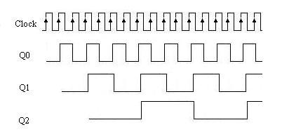
Counters: Ripple counter

Slide 60
Build a 4 Bit Ripple Counter
1. 4 JK flip-flops in toggle mode- all JK inputs tied high
2. Q outputs connected to clock input of following flip-flop
3. FF A = LSB (one with clock input); toggles when input clock
toggles from high to low; FF D = MSB
4. FF B, C, D do not toggle till receive NGT from proceeding FF
5. Direction of count can be reversed by complementing each FF’s output or complementing each FF’s input

Slide 61
Build A Counter that Count from Zero to Nine
1. Determine smallest number of FF’s such that
thus 4 FF’s are required
2. Connect a NAND gate to asynchronous clears of all FF’s
3. Determine which FF’s will be high at count = X
Connect the Q outputs of these FF’s to NAND gate inputs
1
0
1
0

Slide 62
Self-stopping Counter
Counters may be made to stop counting after any desired count by using a gate to inhibit the clock.
Stop at desired count:
D
C
B
A

Slide 63
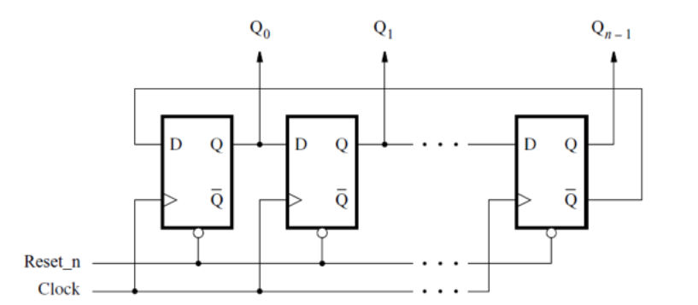


Slide 64
Examples of Different Counter

Slide 65
Counters: Ring counter
Ring counter: Sequence is 1000, 0100, 0010, 0001
Assuming one of these patterns is the starting state
OUT1
OUT2
OUT3
OUT4
IN
D
Q
D
Q
D
Q
D
Q
CLK

Slide 66
Counters: Johnson counter
Johnson counter: Sequence is 1000, 1100, 1110, 1111, 0111, 0011, 0001, 0000
OUT1
OUT2
OUT3
OUT4
IN
D
Q
D
Q
D
Q
D
Q
CLK

Slide 67
Counters: Ripple counter

Slide 68
Build a 4 Bit Ripple Counter
1. 4 JK flip-flops in toggle mode- all JK inputs tied high
2. Q outputs connected to clock input of following flip-flop
3. FF A = LSB (one with clock input); toggles when input clock
toggles from high to low; FF D = MSB
4. FF B, C, D do not toggle till receive NGT from proceeding FF
5. Direction of count can be reversed by complementing each FF’s output or complementing each FF’s input

Slide 69
Build A Counter that Count from Zero to Nine
1. Determine smallest number of FF’s such that
thus 4 FF’s are required
2. Connect a NAND gate to asynchronous clears of all FF’s
3. Determine which FF’s will be high at count = X
Connect the Q outputs of these FF’s to NAND gate inputs
1
0
1
0

Slide 70
Self-stopping Counter
Counters may be made to stop counting after any desired count by using a gate to inhibit the clock.
Stop at desired count:
D
C
B
A

Slide 72
Examples of Different Counter

Slide 73
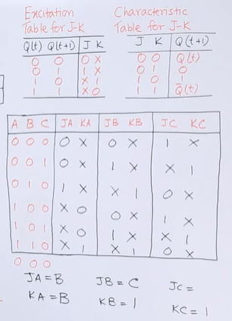
Counter Design: Design a synchronous counter with counting sequence 0,1,2,4,5,6 using J-K flip-flop.

Slide 74
Traffic Signal Problem: Traffic Light Controller

Slide 75
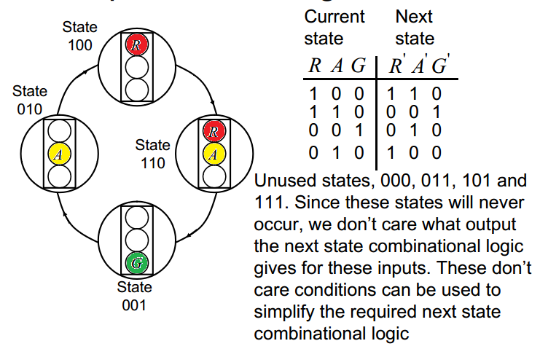
Traffic Signal Problem: Traffic Light Controller

Slide 76
THANKS

